Slide 1
Welcome to Early Years Foundation Stage parents’ meeting
Thursday 11th June 2020

Slide 2
Aims of Today’s Meeting
To help you to understand the curriculum which is covered in the Early Years Foundation Stage.
To give you an insight into uniform, routines etc.

Slide 3
The Staff
Class Teacher: Miss Stansfield and Mrs Meredith
Teaching Assistant: Miss Mundell, Miss Maguire and Mrs Coulthurst

Slide 4
What is the Early Years Foundation Stage?
The Early Years Foundation Stage (E.Y.F.S.) is the stage of education for children from birth to the end of the Reception year.
It is based on the recognition that children learn best through play and active learning.

Slide 5
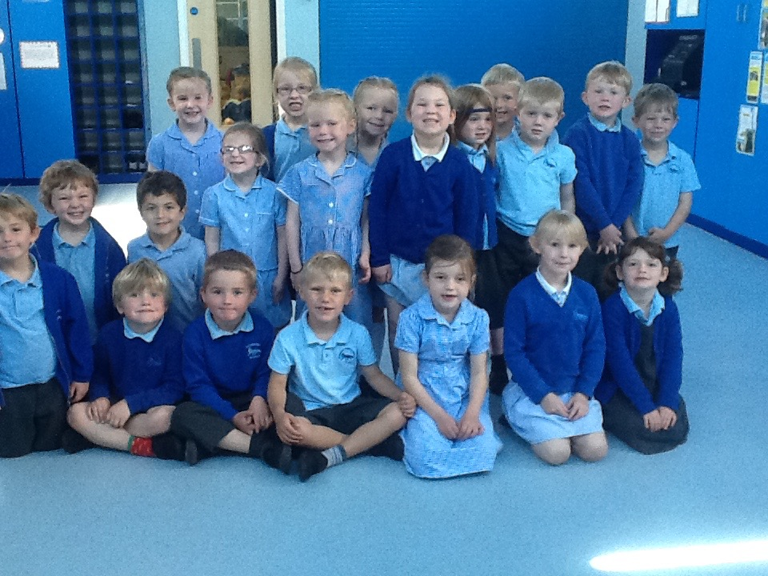
There are 3 Prime Areas of learning and 4 Specific Areas.
The Prime Areas work together and move through to support development in all other areas. The Specific Areas include essential skills and knowledge for children to participate successfully in society.
Personal, Social and Emotional Development
Physical Development
Communication and Language
Literacy
Mathematics
Understanding the World
Expressive Arts and Design

Slide 6
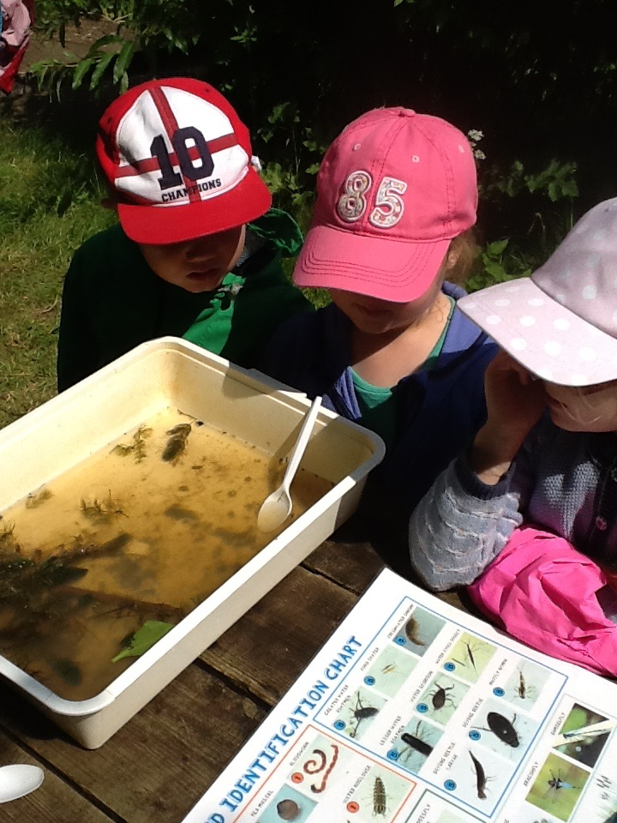
Personal, Social and Emotional Development
The children will be learning to:
become self-confident
make relationships
play co-operatively, taking turns with others
become independent
manage feelings and behaviour.

Slide 7
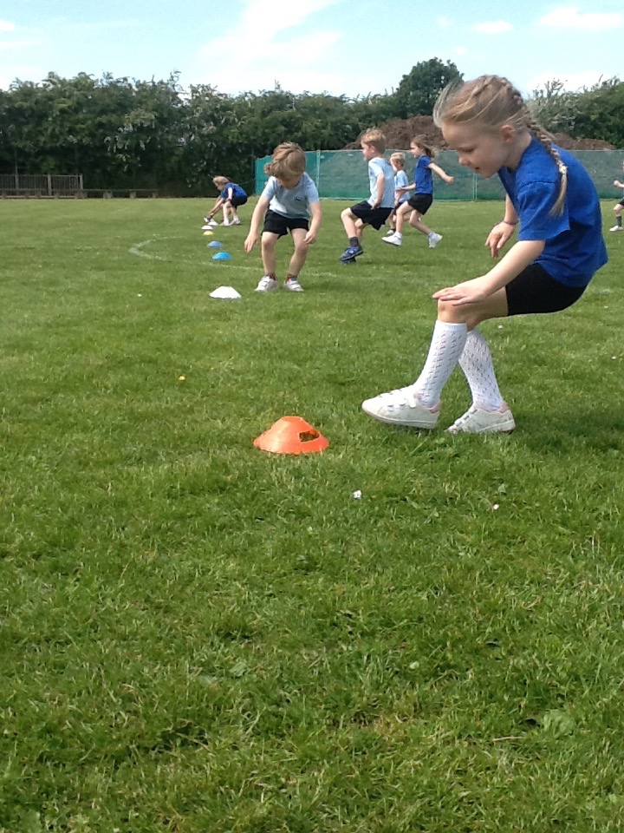
Physical Development
The children will be learning to:
experiment with different ways
of moving
use one handed tools safely
use a pencil effectively for
writing.

Slide 8
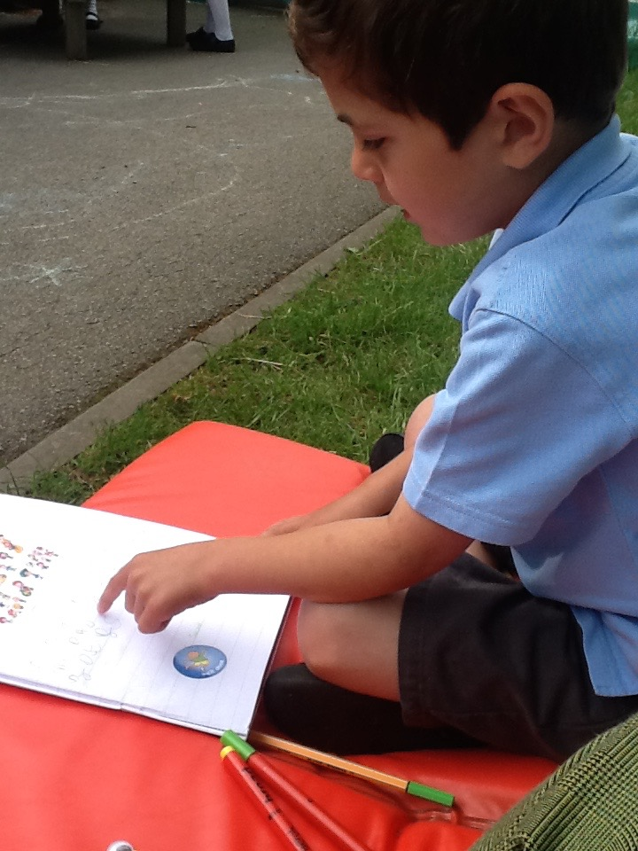
Communication and Language/Literacy
The children will be learning to:
talk confidently and clearly
listen attentively in a range of situations
follow instructions
begin to read simple words
use their phonic knowledge to write words in ways which match their spoken sounds.

Slide 9
Reading
Children will take part in four phonics lessons per week and there will a parents phonics workshop in early September.
First two weeks concentrate on phase 1.
Children will then receive reading books.
Some may contain words, some may not.
Focus on book talk, taking turns reading,
Spotting phonemes and segmenting words.
Try and read four times a week as this will
develop fluency and confidence.
Those children who practise daily, truly benefit.

Slide 10
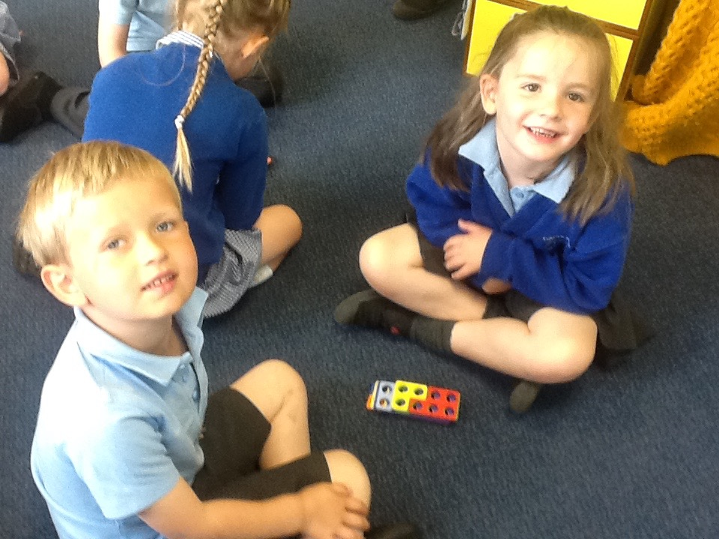
Mathematics
The children will be learning to:
develop an understanding of maths through stories, songs, games and imaginative play
become comfortable with numbers and with ideas of ‘more’ and ‘less’
be aware of shapes, space and measures.

Slide 11
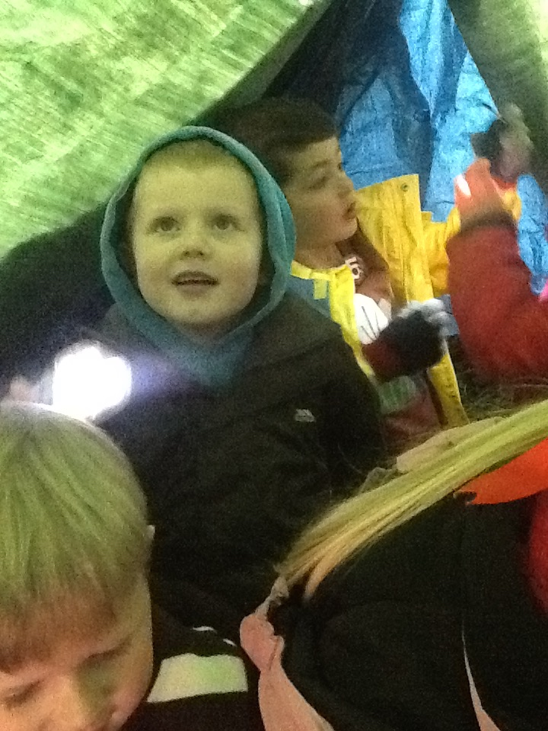
Understanding the World
The children will be learning to:
find out about the world around them,
asking questions about it
build with different materials, know about everyday technology and learn what it is used for
find out about past events in their lives and their families' lives
find out about different cultures and beliefs.
Forest School

Slide 12
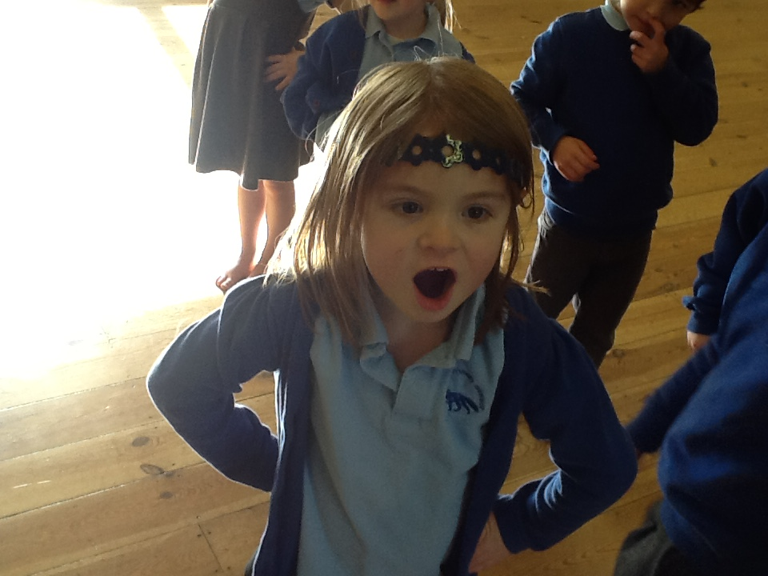
Expressive Arts and Design
The children will be learning to:
make different things
role play
dance
stories
making music
singing songs.

Slide 13
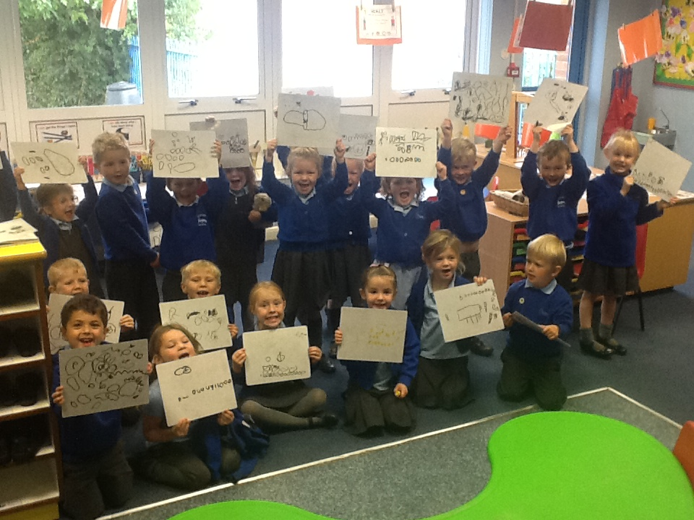
Our Topics
Autumn Term 1
All About Me and…
Developing Class and School Routines!

Slide 14
The first few weeks
We will find out what the children
already know and can do
and use this information to help us plan for their individual needs.
Wednesday 26th August and Thursday 27th August– Home Visits
Friday 28th August– Transition Day AM/PM slot
Tuesday 1st September– Children start full time. School gates open from 08:40-09:00.

Slide 15
Assessment
Children are assessed in Foundation Stage on a daily basis through observations.
Statutory Baseline assessment
We learn about children.
We can focus on achievements rather than failures.
We can become aware of how children function across all areas of the curriculum.
We can identify next steps in learning.
We can begin to see learning from the point of view of the child.

Slide 16
Gaddesby Values

Slide 17
WOW Moments
We value any contribution that you would like to make to this in helping us meet your child’s needs.
We will give each child a template for you to document any WOW moments.

Slide 18
School Readiness
Website has some great resources on it.

Slide 19
Uniform
Tesco
School Trends
Kidz Zone
Enter school name onto website and it pulls up details.
Plimsols for inside school. Trainers for PE.

Slide 20
First Day of School– Tuesday 1st September
Book bag
P.E kit in a drawstring bag.
On the following Monday, children will need to come to school dressed in Forest School clothes and with their school uniform to change into.
Drop off and collection. Drop off directly to the door and pick up from Gaddesby pre-school car park. We will send children to you at 15:05.

Slide 21
Cool Milk
All children need to be registered to receive free milk up until the age of 5.
After this point if you would like your child to receive milk, will need to contact Cool Milk and pay.

Slide 22
School Dinners
Three week rolling programme, all freshly cooked on site.
Children will receive free hot dinners.
Menus available on Gaddesby website and you will be notified of any menu changes.
Children choose via pictures.

Slide 23
Pupil Premium
Schools are given a pupil premium for:
Children who have qualified for free school meals at any point in the past six years. The school receives £1320 for each of these children.
Children who are or have been looked after under local authority care for more than one day. These children are awarded a premium of £2300.
Children from service families who receive a child pension from the Ministry of Defence. They are awarded £300.

Slide 24
Kiss and Drop system/ school bus.

Slide 25
And Finally…
If you have any worries or concerns please come in and see us and we will do our best to help you ☺
kstansfield@gaddesby.bepschools.org
Contact me if you have any questions or to pass on information .
Thank you for coming – any questions ?
.

