Slide 1
So, what is phonics?

Slide 2
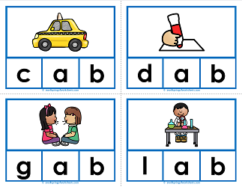
New Vocabulary
grapheme
phoneme
blending
segmenting

Slide 3
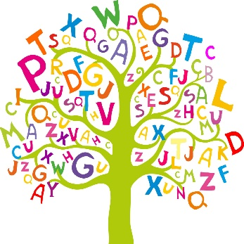
Levels in Phonics
Level 1: focus on speaking and listening. Oral blending and segmenting. 'The more words children know and understand before they start on a systematic programme of phonic work the better they are equipped to succeed.’ The children work on activities including rhyming, instrumental sounds and natural environmental sounds.
Level 2: The beginning of teaching the alphabet. The sounds are not taught in alphabetical order but based on a systematic approach which allows the learner to read words from the beginning of their reading journey. The first sounds the children learn to read are s a t p i n. The children are soon able to blend short words together like pin. Grapheme-Phoneme correspondences (GPC's) begin. Some digraphs are taught such as ‘ck’ and ‘ff’.
Level 3: completes teaching of alphabet and children move on to learning one grapheme for each of the 44 phonemes. The children continue to meet consonant and vowel digraphs.
Level 4: During this level, the focus moves towards words with adjacent consonants. Recap, consolidation and practice of Phase 3 graphemes whilst rehearsing blending polysyllabic words.
Level 5: In Level 5, the children are introduced of alternative phoneme and grapheme choices and representations. They learn that there are often multiple pronunciations for a grapheme such as ‘ch’ can make the ‘ch’ should in chain but the ‘sh’ sound in chef an d the ‘c’ sound in Christmas.
Level 6: This level is taught in Year 2 alongside the Year 2 spelling curriculum from the national curriculum. During this level, we recap, consolidate and practice of all phases with a stronger emphasis on spelling choices.

Slide 4
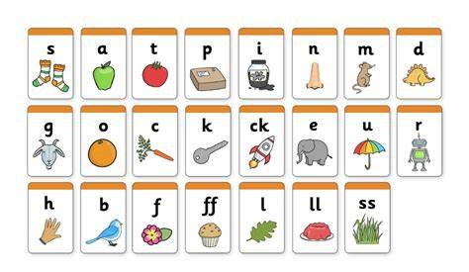
http://www.youtube.com/watch?v=BqhXUW_v-1s
Vocabulary
grapheme
phoneme
blending
segmenting
digraph
trigraph
a letter or sequence of letters that represent a phoneme
a sound in a word
putting all the sounds together
Two letters makes one sound
Three letters makes one sound
1 | 2 | 3
c | a | t
b | ir | d
f | i | sh
kn | igh | t
Notes:
Play video. Everyone join in.
Robot arms the four words to practise segmenting.

Slide 5
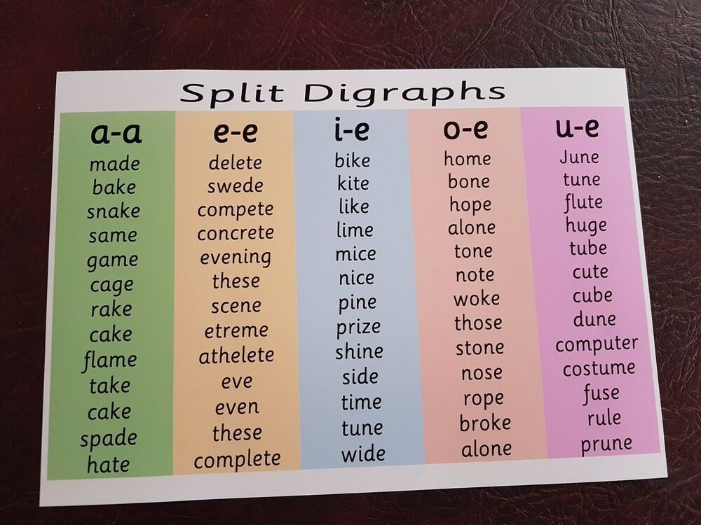
Split digraphs
i_e time
a_e make
u_e cube/flute
o_e broke/spoke
e_e scene/extreme

Slide 6
What writing might look like whilst your child is learning phonics. - Praise phonetic attempts. - Encourage the correct spelling of high frequency words
nite
wighl
beecos
yoo
jumpt
Notes:
Discuss supporting writing at home using phoneme frames. Segment the word they are trying to write, how many sounds should you be writing down. Model this on the flipchart.

Slide 7
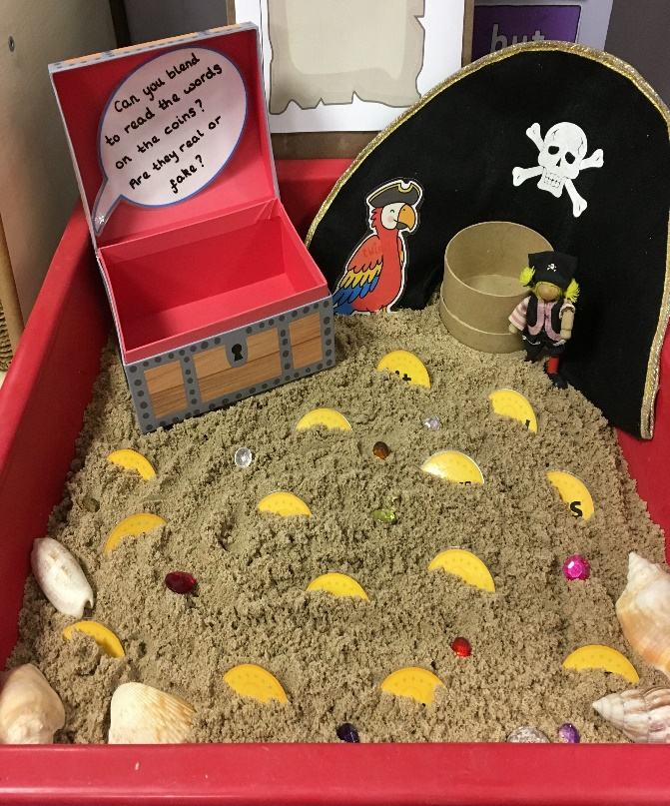
Example of a phonics lesson Introduce Revisit Teach Apply Practise
Notes:
Explain what a phonics lesson looks like

Slide 8
Reading books
Whilst your child is accessing Level 1 – Level 5 phonics lessons, your class teacher will send home books which are phonetically decodable. This means the words in the book can be read using phonics and will include the tricky words at the appropriate level for your child’s learning.
When the children are secure in level 5 phonics, the class teacher will then move the children onto colour banded books. These books are not often phonetically decodable and rely on the children using sight reading, contextual clues and other reading strategies rather than purely phonics. Your child’s book band will not only depend on their ability to read the words but also their understanding of the text.
Notes:
Bring in phonics books and book band books

Slide 9
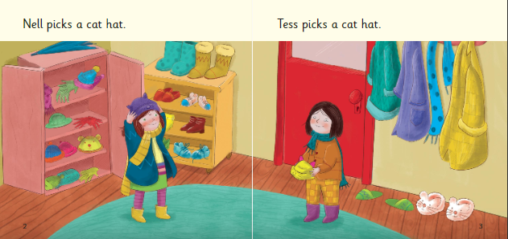
Supporting your reader at home
Notes:
Model supporting a Level 2 reader.

Slide 10
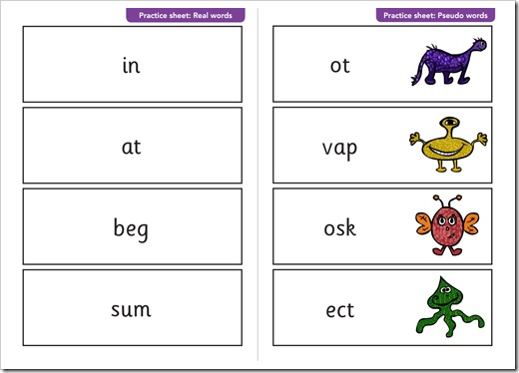
Phonics test End of Year 1 Lots of practising done prior to test Level 5 secure.
Notes:
Bring a phonics screen to show. Explain what this looks like in practise.

Slide 11
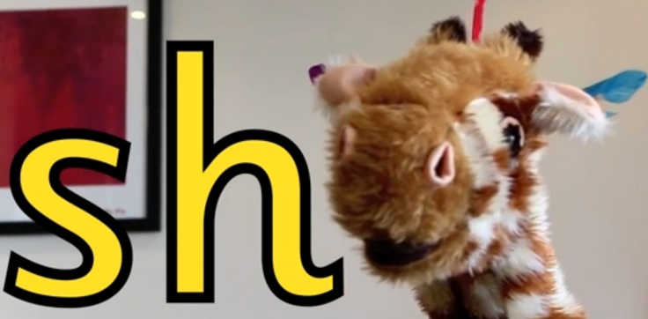
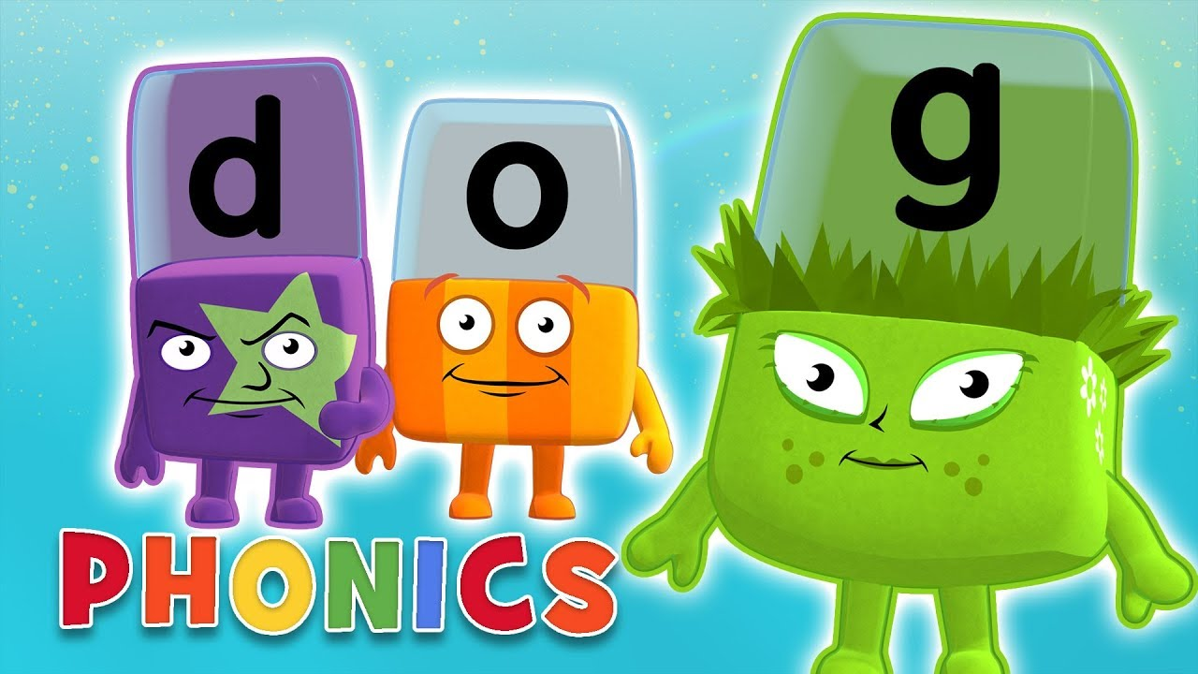
Useful resources/website
Mr Thorne
https://www.youtube.com/channel/UC7sW4j8p7k9D_qRRMUsGqyw
http://www.phonicsplay.co.uk/
http://www.letters-and-sounds.com/
BBC Phonics
Notes:
Print as hand outs

