Slide 1
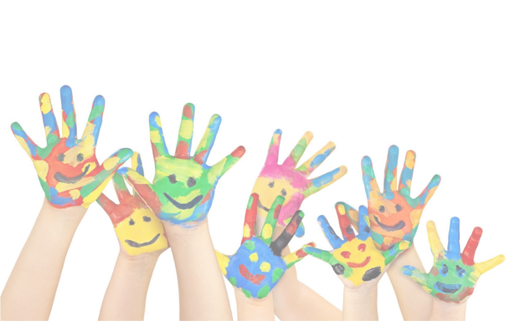
Welcome to Early Years Foundation Stage parents’ meeting
Thursday 25th June 2026

Slide 2
Aims of Today’s Meeting
To help you to understand the curriculum which is covered in the Early Years Foundation Stage.
To give you an insight into uniform, routines etc.

Slide 3
The Staff
Class Teacher: Mrs Benney (Mat leave until Easter 2027), Mrs Meredith and ________
Teaching Assistant: Miss Mundell (morning support).

Slide 4
What is the Early Years Foundation Stage?
The Early Years Foundation Stage (E.Y.F.S.) is the stage of education for children from birth to the end of the Reception year.
It is based on the recognition that children learn best through play and active learning.
Around 20% of learning done in the classroom– 80% is consolidated at home. So as much support that you can offer will be truly appreciated!

Slide 5
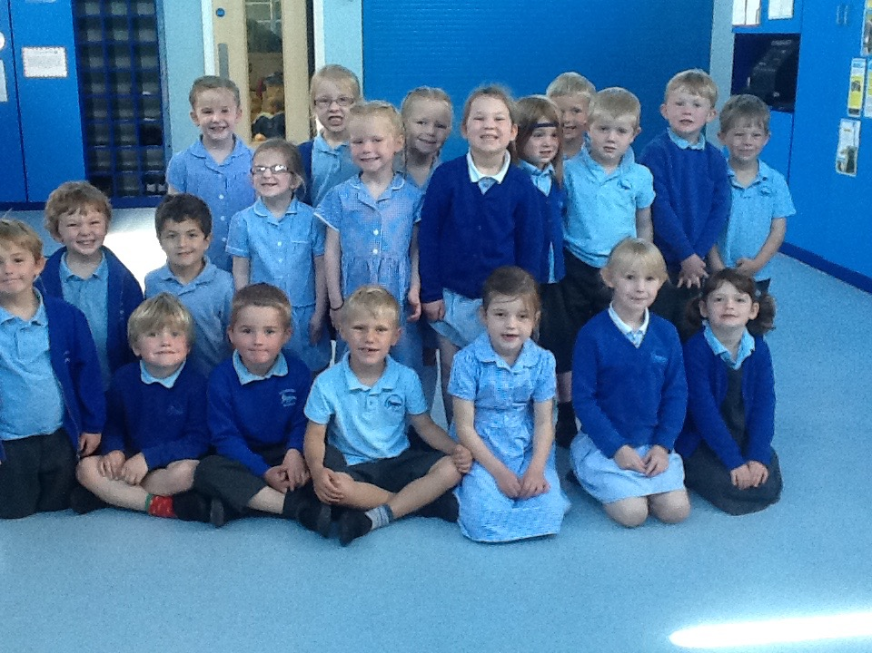
There are 3 Prime Areas of learning and 4 Specific Areas.
The Prime Areas work together and move through to support development in all other areas. The Specific Areas include essential skills and knowledge for children to participate successfully in society.
Communication and Language
Personal, Social and Emotional Development
Physical Development
Literacy
Mathematics
Understanding the World
Expressive Arts and Design

Slide 6
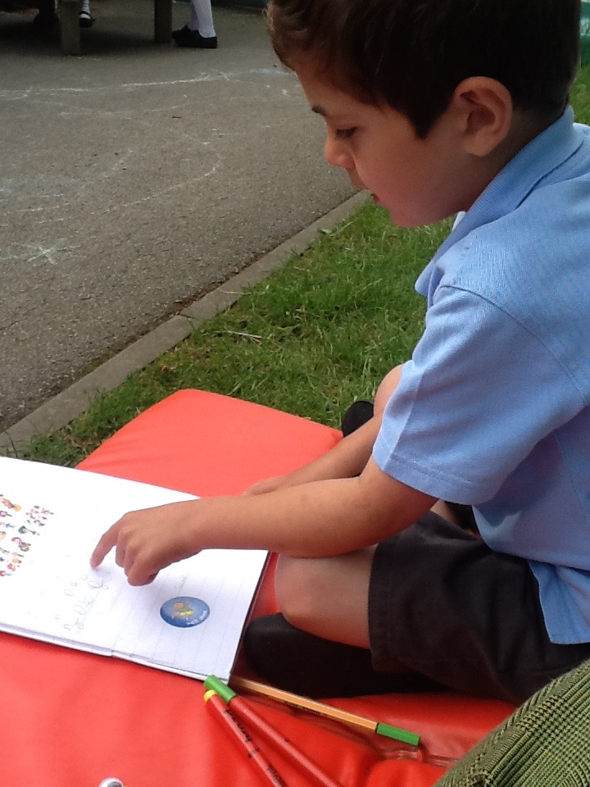
Communication and Language
There is a huge focus on this prime area in the
new curriculum, as it underpins every area of
learning!
The children will be learning:
Listening, Attention and Understanding*-
listen attentively, hold conversations and
make comments about what they have heard.
Speaking- participate in class discussions,
offer explanations and express their ideas
using full sentences.

Slide 7
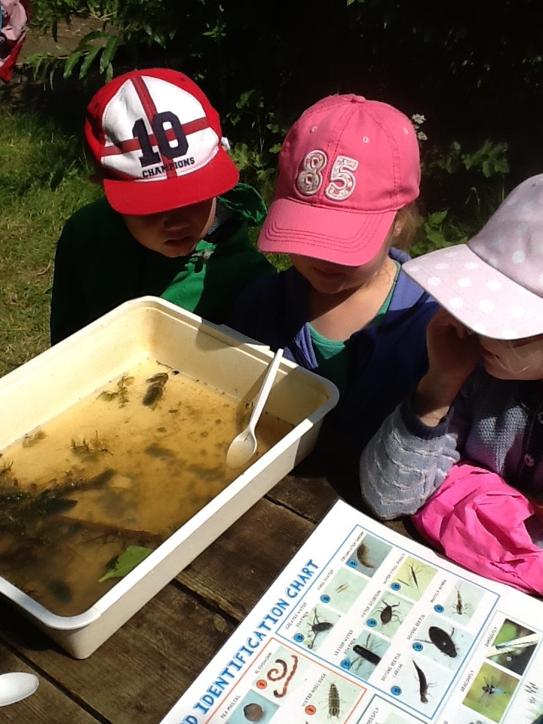
Personal, Social and Emotional Development
The children will be learning:
Self-regulation*- showing an understanding
towards their feelings and others, working towards
goals and giving focused attention.
Managing self*- showing confidence, resilience,
understanding right and wrong and managing basic
hygiene needs.
Building relationships*- working collaboratively,
forming positive relationships, showing sensitivity
towards others.

Slide 8
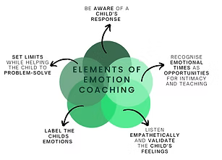
Personal, Social and Emotional Development
Self-regulation*- showing an understanding towards their feelings and others, working towards goals and giving focused attention.
This year Mrs Benney and Mrs Meredith went on training, bespoke to the Early Years, to support children with developing their self regulation and understanding of emotions.
This upcoming year we are adopting Emotion Coaching, which consists of three steps:
Step 1: Recognising, empathising, validating the feelings and labelling them
Communicating that feelings are ok and that you understand how they feel.
Step 2: Setting limits on the behaviour. If a child has made the wrong choice, we need to remind them of the school rules.
Step 3: Problem solving with the learner about how they can move forwards (this needs to be done when the child is calm).

Slide 9
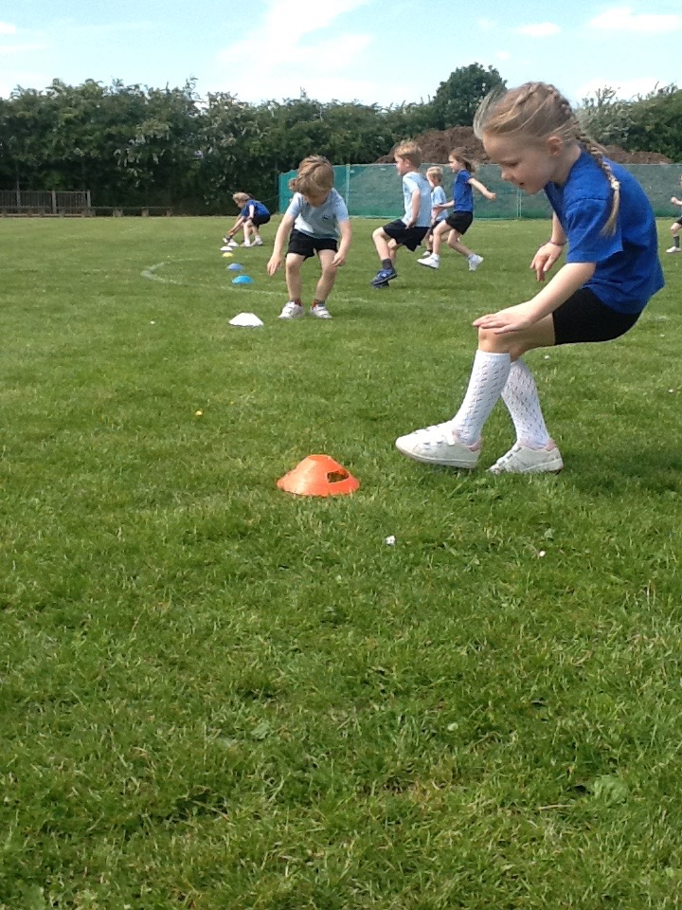
Physical Development
The children will be learning:
Gross motor skills* - negotiating space,
demonstrating strength and moving energetically in
a range of ways (running, dancing etc).
Fine motor skills*- using small tools, showing
accuracy when drawing and holding a pencil
effectively for early writing.

Slide 10
Literacy
The children will be learning:
Comprehension*- demonstrate an
understanding of what they have read, use
vocabulary introduced through stories/poems/
non-fiction and anticipate to key events.
Word Reading*- say a sound for each letter
in the alphabet, will learn phase 3 digraphs, be able to read words using phonetic skills and re aloud simple sentences and tricky words.
Writing- write recognisable letters which are correctly formed, spell simple words and write sentences that can be read by others.

Slide 11
Literacy continued…
Children will take part in four phonics lessons per week and there will a parents phonics workshop in early September.
This year our school will be changing to a new phonic
programme called Read, Write, Inc.
First two weeks concentrate on stage 1.
Children will then receive reading books.
Reading books WILL NOT contain words.
Focus on book talk, taking turns reading,
Spotting phonemes and segmenting words.
Try and read four times a week as this will
develop fluency and confidence.
Those children who practise daily, truly benefit and will become confident fluent readers by the end of EYFS.

Slide 12
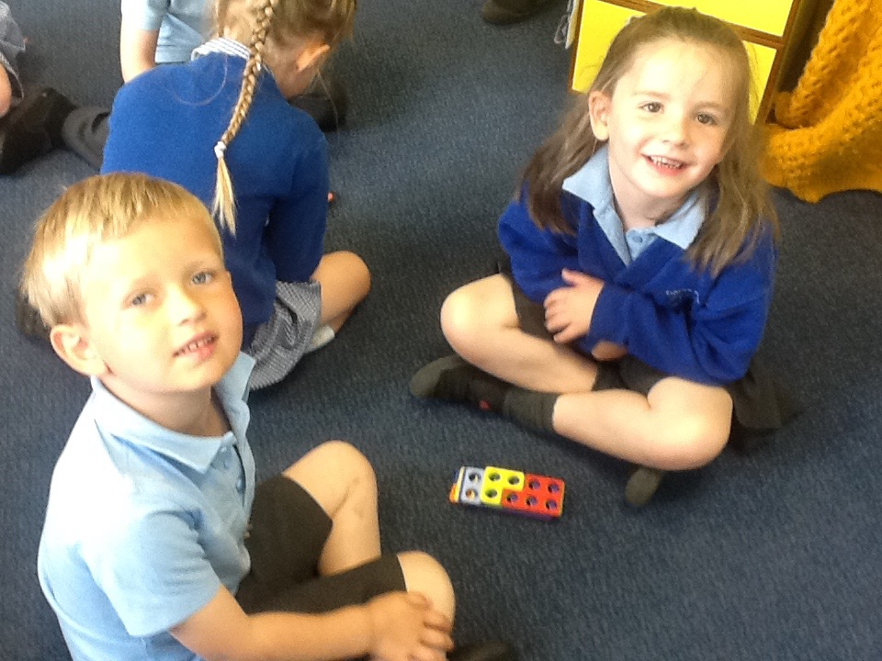
Mathematics
The children will be learning:
Number*- have a deep understanding of
numbers to 10 (including the composition of those numbers), subitise to 5 and to automatically recall number bonds to 10 (composition).
Numerical Patterns*- verbally count beyond 20, compare quantities of number and will explore and represent patterns within numbers to 10 (including odd and even exploration, doubling facts and sharing amounts).
Teach maths through our maths lesson, but we also enhance mathematics through Quick Math session. These sessions develop mathematical fluency.

Slide 13
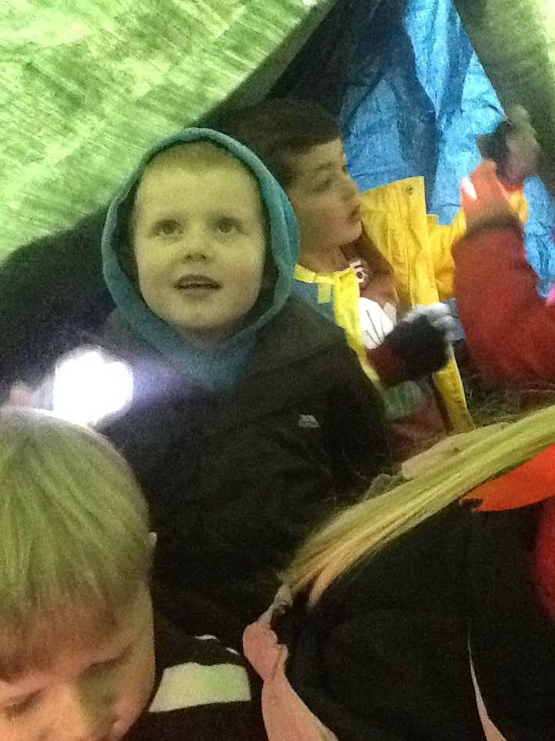
Understanding the World
The children will be learning:
Past and Present*- talk about the lives of people
around them and their roles, understanding
similarities and differences between the past
and present and to develop an understanding of the past through the use of stories and non-fiction texts.
People, Culture and Communities*-describe their immediate environment, know similarities and differences between different religions and communities and to learn about differences between life in this country and other countries.
The Natural World*- explore the world around them, understand important processes (seasons) and explore different environments.
Forest School– every Monday afternoon! Come rain or shine!

Slide 14
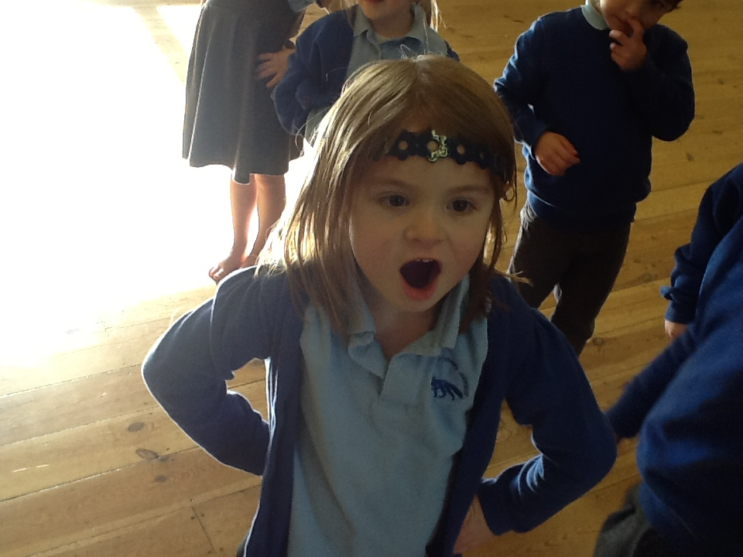
Expressive Arts and Design
The children will be learning:
Creating with materials*- safely
use different materials and tools,
share their creations and make use
of props and materials when role
playing.
Being imaginative and expressive*- invent, adapt and recount narratives, sing well known songs and nursery rhymes and perform songs/stories/poems with others and in time with music.

Slide 15
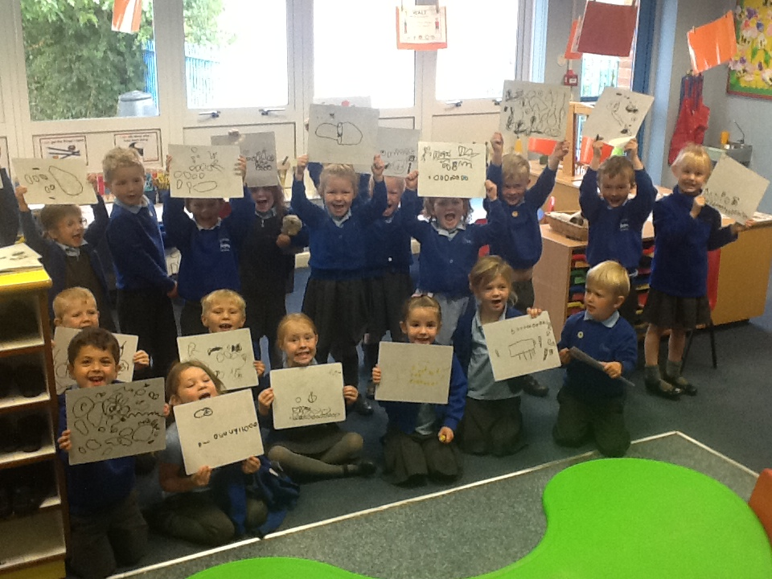
Our Topics
Autumn Term 1
All About Me and…
Developing Class and School Routines!

Slide 16
The first few weeks
We will find out what the children
already know and can do
and use this information to help us plan for their individual needs.
Wednesday 26th August – Children start full time at 08:40. Gates open five minutes before.
On the first day parents are welcome to come into the classroom, but after that point please can children be dropped off at the classroom door. This is for health and safety and safeguarding reasons.

Slide 17
Assessment
Children are assessed in Foundation Stage on a daily basis through observations.
Statutory Government Baseline assessment!
We learn about children.
We can focus on achievements rather than failures.
We can become aware of how children function across all areas of the curriculum.
We can identify next steps in learning.
We can begin to see learning from the point of view of the child.

Slide 18
Gaddesby Rules
Kind
Safe
Ready
Respectful

Slide 19
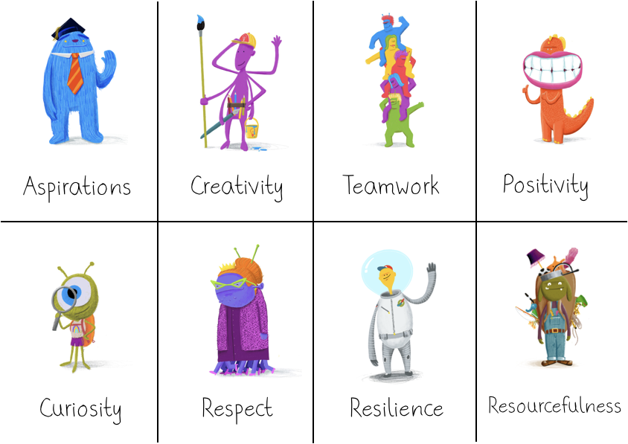
Gaddesby Values

Slide 20
School Readiness
Website has some great resources on it.
What are we looking for?
-Happy children ☺
- Toileting independently– children will need to be able to wipe their own bottoms.
- Getting changed and managing own belongings– lots of practise in the holidays ready for PE and Forest School.

Slide 21
Uniform– please label everything!
School Trends
Enter school name onto website and it pulls up details.
Plimsols for inside school. PE kit and trainers (any colour) for PE in a labelled bag (kept in school).

Slide 22
First Day of School– Wednesday 26th August
Book bag
P.E kit in a drawstring bag.
On Monday, children will need to bring Forest Schools in a labelled bag, we will change into these after dinner.
Drop off and collection at classroom door. Please collect your child at 15:10 (gate will open five minutes before this time).

Slide 23
Cool Milk
All children need to be registered to receive free milk up until the age of 5– parents to action this.
After this point if you would like your child to receive milk, will need to contact Cool Milk and pay.
There is an information sheet on the school website.

Slide 24
School Dinners
Three week rolling programme, all freshly cooked on site.
Children will receive free hot dinners.
Menus available on Gaddesby website and you will be notified of any menu changes.
Children choose via pictures every morning.

Slide 25
Arbor– to be actioned when your child starts school
Arbor is a system that support parent payments and communications. The Arbor app needs to be download from your phones Appstore.
Downloading the Arbor App
Important - when you are setting up your account via the Arbor website please use a laptop or a computer and Google Chrome, after your first time logging in you can download the Arbor App on your phone and login via there. Your username is your personal email address that you receive communications from school on. You will need to set a password, you may need to click on ’forgotten password’. On your first login only you will need to enter your child's date of birth.
Communications
E-mails will come through to you as usual– we will use the App to send you messages - you will need the Arbor App to view them. To report a child absent please message us through the Arbor App only.
School Trips and Meals
You will be able to use this new platform to pay for school meals (Relevant to KS2 Children only) and trips.

Slide 26

Class Dojo
Class Dojo is a closed platform, meaning only parents who are connected to their own child’s account can access it. This ensures updates and photos are securely shared. One of the real strengths of this system is that you will no longer have to wait for newsletters to see what children have been doing in class – you’ll be able to enjoy these updates in real time.
There is also the option to upload photos of activities and achievements from home to children’s portfolios for them to share in school with their teachers.
Children will bring home a QR code with instructions for parents on how to download and access Class Dojo, once they have started school.
Communication between class teacher and parents is done through Class Dojo.

Slide 27
Pupil Premium– please notify us if you qualify.
Schools are given a pupil premium for:
Children who have qualified for free school meals at any point in the past six years. The school receives £1480 for each of these children.
Children who are or have been looked after under local authority care for more than one day. These children are awarded a premium of £2570.
Children from service families who receive a child pension from the Ministry of Defence. They are awarded £350.

Slide 28
School bus– catchment areas.

Slide 29
And Finally…
If you have any worries or concerns please come in and see us and we will do our best to help you ☺ We can be contacted through our school email address.
office@gaddesby.bepschools.org
Contact us if you have any questions or to pass on information .
Thank you for coming!
.

